Slide 1

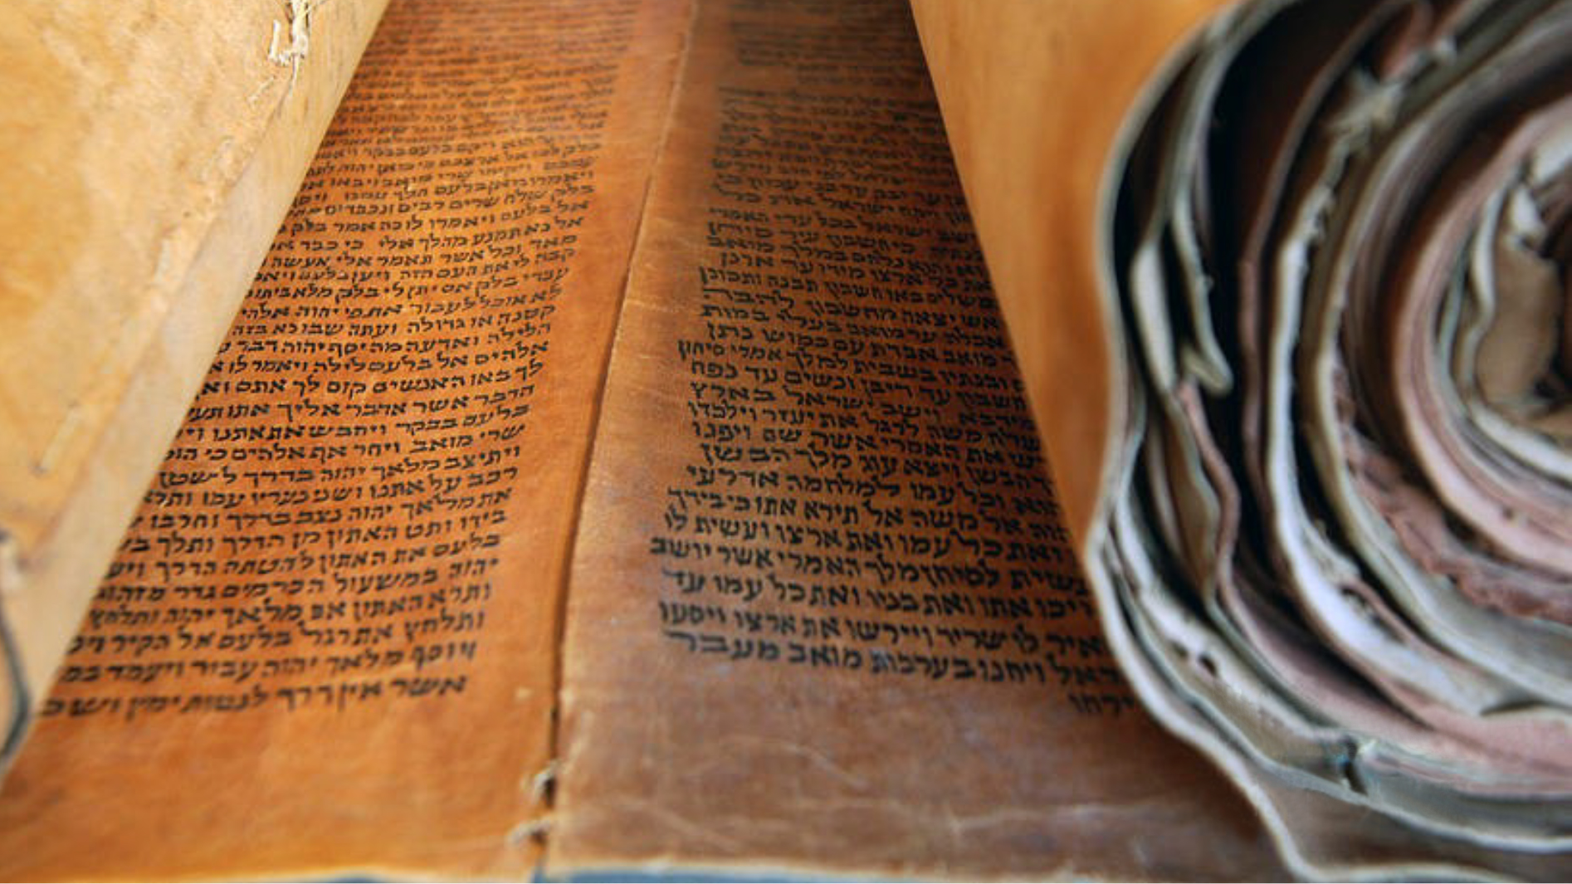


JOURNEY THROUGH the OLD TESTAMENT
What is it and why does it matter?

Slide 2
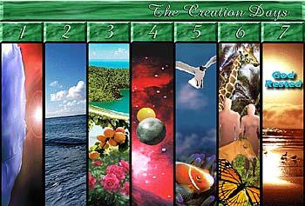
GENESIS 1-3: Creation, Man, the Fall
CREATION

Slide 3
GENESIS 1?
Poetic theology
Evolutionary ages
Scientific 24/7
Blend scientific data & poetic

Slide 4
LITERARY STRUCTURE
Problem (v2) | Preparation (days 1-3) | Population (days 4-6)
DARKNESS | A light (day) B darkness (night) | 4a sun 4b moon, stars
WATERY ABYSS | A firmament B waters above/below | 5a birds 5b fish
FORMLESS EARTH | A earth from sea B vegetation | 6a land Animals 6b humans

Slide 5
PURPOSES FOR HUMANITY
DOMINION
WORK
RELATIONSHIP
There’s a fourth coming…

Slide 6
PURPOSES FOR HUMANITY
DOMINION
WORK
RELATIONSHIP
There’s a fourth coming…

Slide 7
PURPOSES FOR HUMANITY (Genesis 1-2)
Dominion
Work
Relationship
There’s a fourth coming…

Slide 8
DOMINION
Goodness of creation
Rebellion & broken creation
God promises to restore
Sin grows
God chooses a family

Slide 9
PLAN
(EXODUS – DEUTERONOMY, WISDOM)
God’s plan to redeem
Family to nation
Nation formed & delivered
Covenant, promises, new lifestyle
How to live faithfully

Slide 10
PROBLEM
(historical books)
Cycle of disobedience
Repeated failure
Wicked kings, false prophets
Idolatry
Unable to be inside what the law demands outside

Slide 11
PREPARATION
(PROPHETS)
Beginning of new promise
Perfect king, priest, prophet
Fulfill law spiritually
Write God’s law on human heart
Inhabit a temple of flesh (Incarnation, Holy Spirit)

Slide 12
OT THEOLOGICAL SUMMARY
PROMISE
PLAN
PROBLEM
PREPARATION

Slide 13
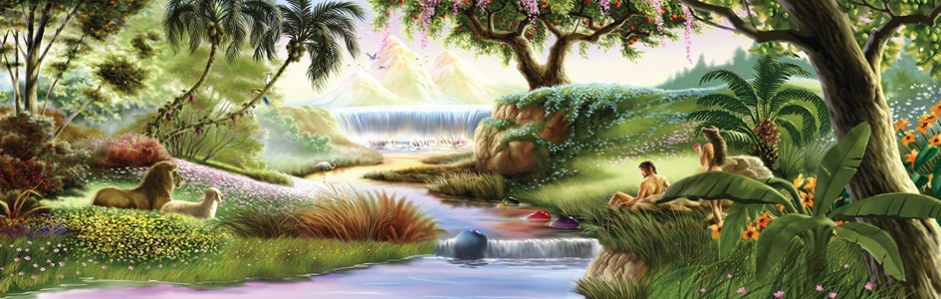
GENESIS 1-3: Creation, Man, the Fall
THE GARDEN

Slide 14
PURPOSES FOR HUMANITY
DOMINION
WORK
RELATIONSHIP
And now let’s add #4 - WORSHIP

Slide 15

GENESIS 1-3: Creation, Man, the Fall
THE TREES
Tree of Life
Tree of the Knowledge of Good & Evil

Slide 16


Slide 18
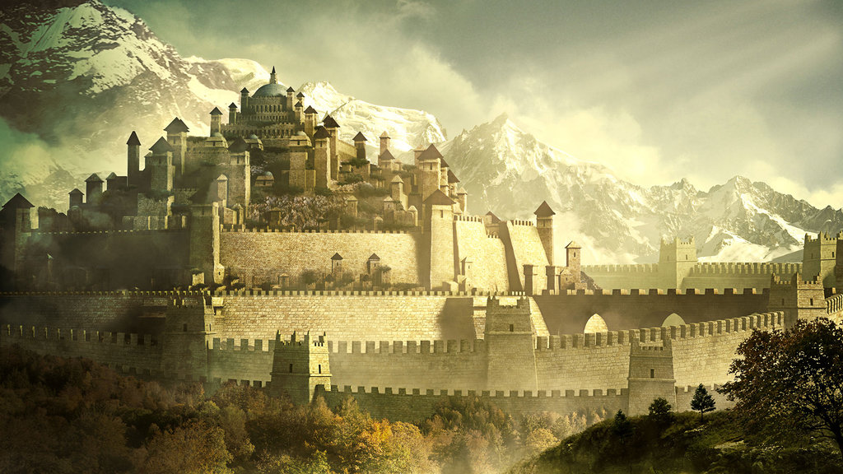
RULER. PEOPLE. LAND.

Slide 19

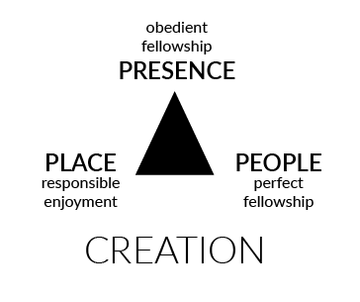


Slide 20
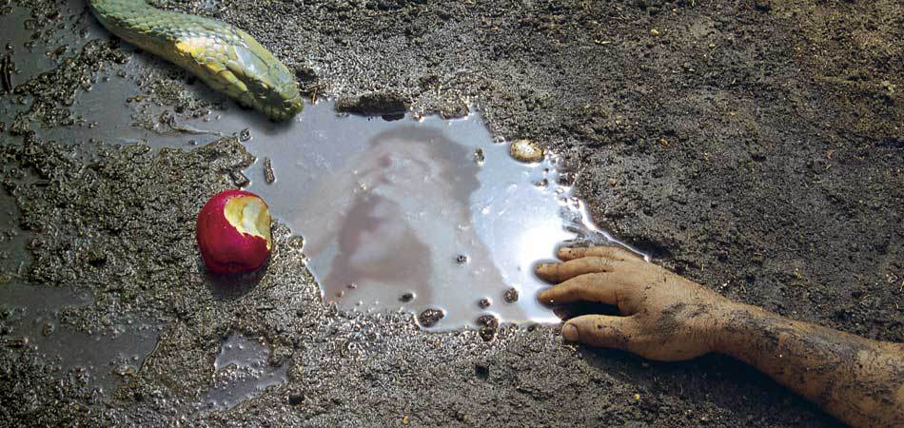
GENESIS 1-3: Creation, Man, the Fall
THE FALL

Slide 21
GENESIS 1-3: Creation, Man, the Fall
QUESTIONS
“Where are you?”
“Who told you?”
“What is this you have done?”

Slide 22
ARUM

Slide 23
Incurvatus in se

Slide 24
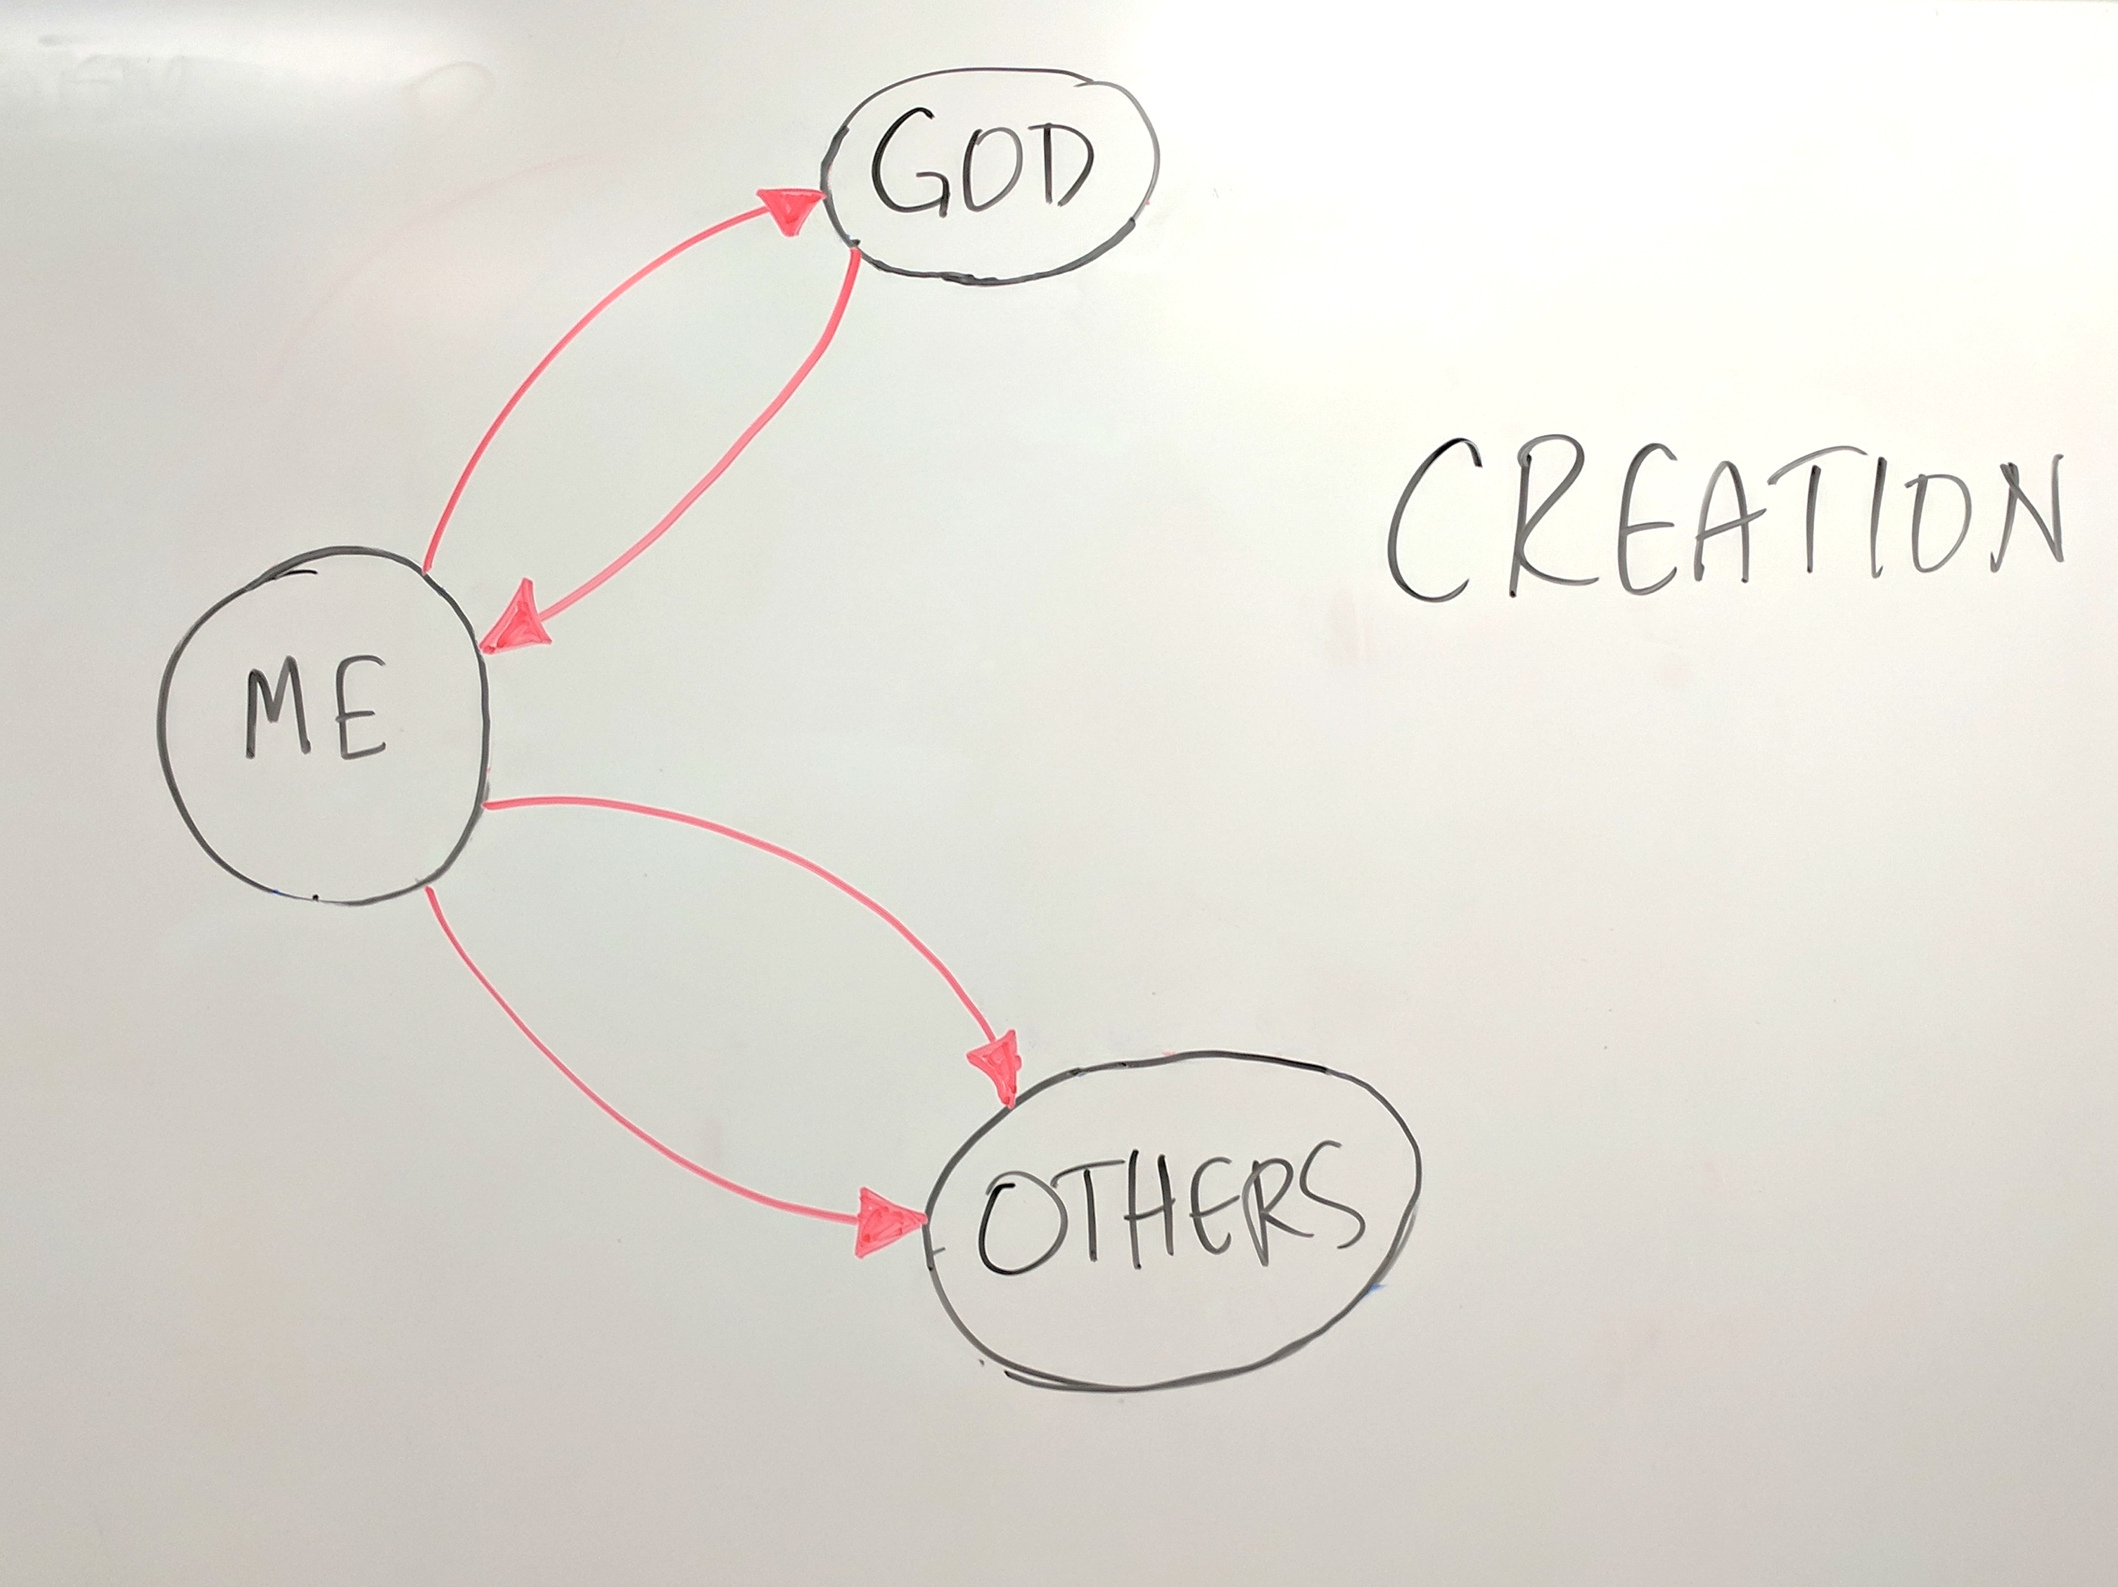

Slide 25
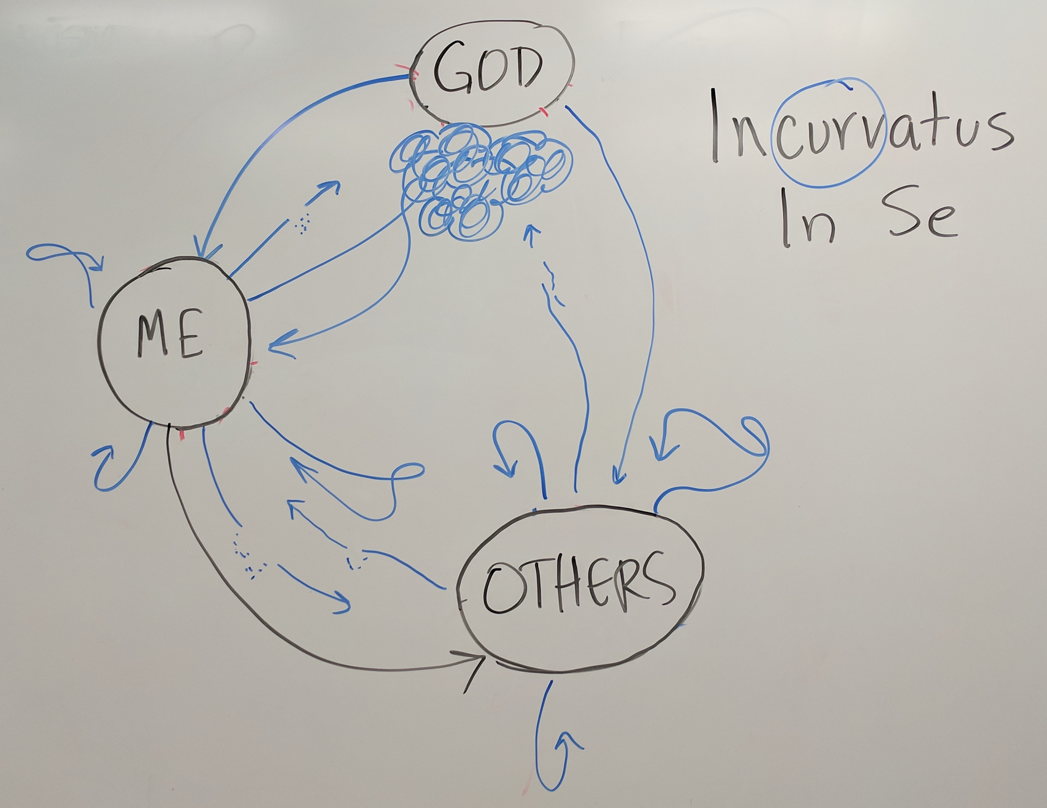

Slide 26

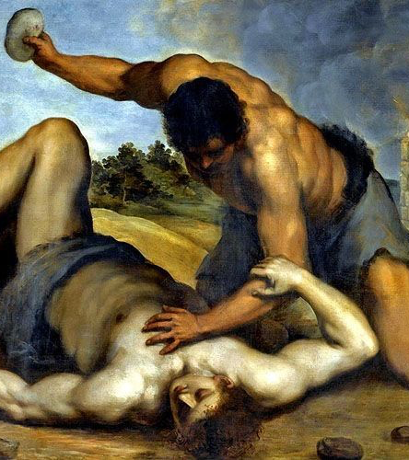
“WHERE IS YOUR BROTHER?”
GENESIS 1-3: Creation, Man, the Fall

Slide 27
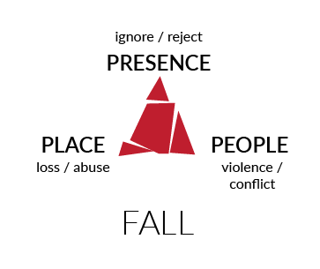

Slide 29
The Spread of Sin & A New Start
GENESIS 4-11
PERSONAL
UNIVERSAL
INTENSIVE
EXTENSIVE

Slide 30
Why is God so angry in Gen. 6?

Slide 31
NOAH & THE FLOOD
Deliverance from a sin-wrecked world

Slide 32
Tower of Babel
GENESIS 11
UNIVERSAL
EXTENSIVE

Slide 33
Patriarchs: God Chooses a Family
GENESIS 11-50

Slide 34
Ancient City-state of Ur (circa 2000 BC)

Slide 38
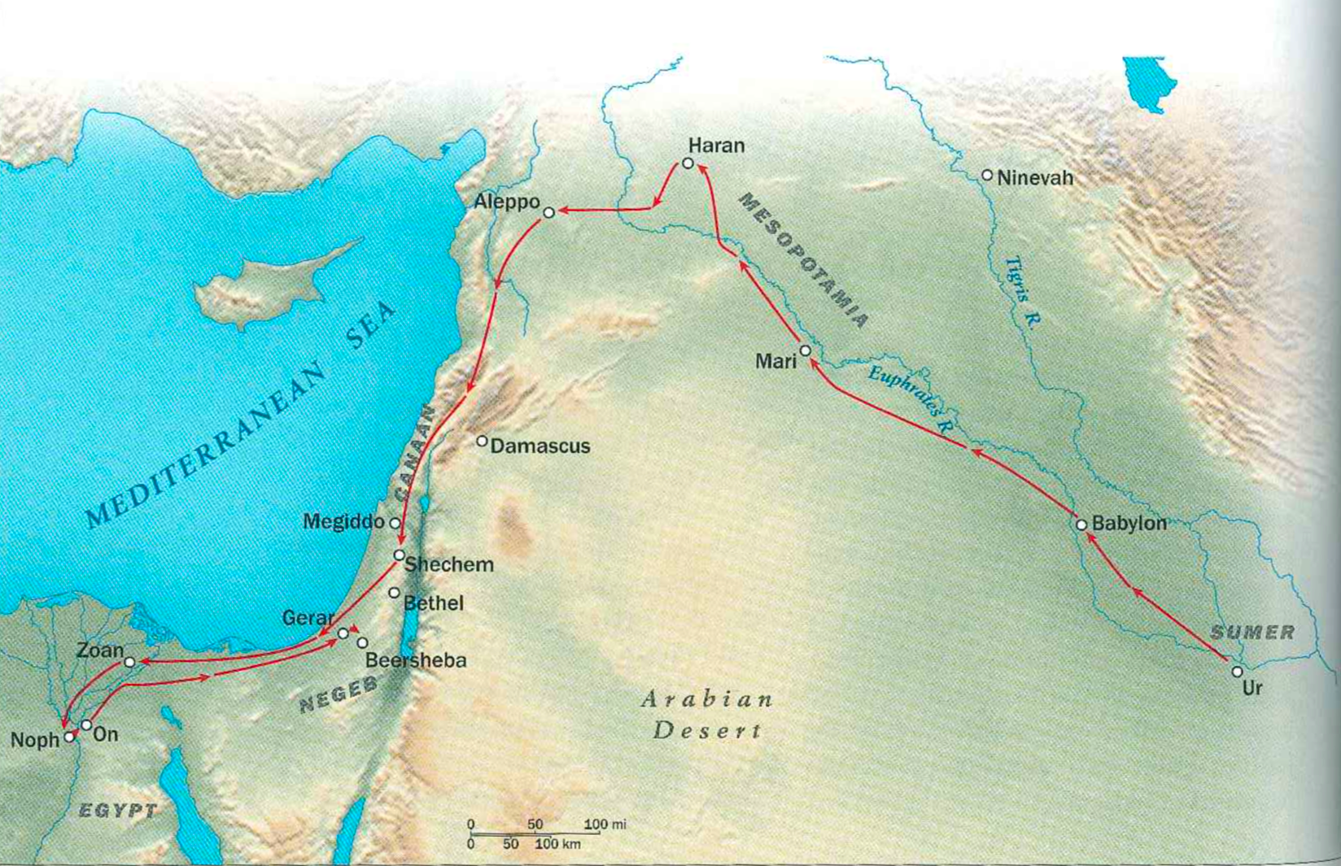
GENESIS 11-50

Slide 39
Covenant with Abraham (15)
Promise of descendants
Childless?
Promise to give land
“Cutting” ceremony
God is only participant

Slide 40
Covenant (17)
A great nation
Kings
Requires obedience
I will be your God
Circumcision = symbol
Obedience = evidence

Slide 41
Tombs at hebron
Notes:
MIDDLE (25-37)
Birth of Jacob & Esau
Life of Jacob
Descendants of Esau (Edomites)

Slide 42
Joseph in Egypt
Notes:
END (37-50)
Joseph’s captivity
Flight to Egypt during famine
Family dwelling in Egypt sets stage for Exodus

Slide 43
Abraham
LOT
MOAB AMMON
Ishmael
Isaac
Other sons
Esau
Jacob
Moabites
ammonites
12 sons
israelites
12 tribes in arabia
MIDIANITES
Edomites
Notes:
ISRAEL’S HISTORICAL ENEMIES
Lot’s descendants
Moabites
Ammonites
Ishmael’s descendants
Arabian tribes supporting Canaanite
Midianites (Midian, son of Keturah)
Esau’s descendants

